Slide 1
Computer Systems An Integrated Approach to Architecture and Operating Systems
Chapter 6
Processor Scheduling
©Copyright 2009Umakishore Ramachandran and William D. Leahy Jr.

Slide 2
6.1 Introduction
Things to Do
Laundry
Study for Test
Cook and eat dinner
Call Mom for her birthday
How would you do it?

Slide 3
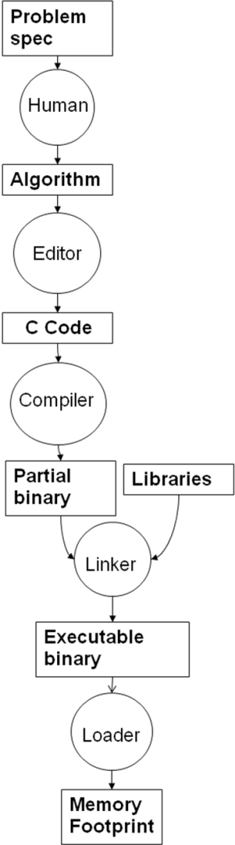
6.2 Programs and Processes
What is an operating system?
What are resources?
How do we create programs?

Slide 4
6.2 Programs and Processes
What is the memory footprint of a user program?
What is the overall view of memory?
Why?
Low memory
Use by the OS
Program code
Memory footprint
of
User program
Program 1
Program global data
Program heap
Program 2
Program stack
High memory
Use by the OS
.
.
.
Program n
OS Data
Structures
OS routines

Slide 5
6.2 Programs and Processes
What resources are required to run:
Hello, World!
What is a scheduler?
Program Properties
Expected running time
Expected memory usage
Expected I/O requirements
Process/System Properies
Available system memory
Arrival time of a program
Instantaneous memory requirements
Process 1
Process 2
.
.
.
scheduler
Processor
winner
Process n

Slide 6
6.2 Programs and Processes
Program
Process
On disk
Static
No state
No PC
No register usage
Fixed size
In memory (and disk)
Dynamic – changing
State
PC
Registers
May grow or shrink
Fundamental unit of scheduling
One program may
yield many processes

Slide 7
6.2 Programs and Processes
Name | Usual Connotation | Use in this chapter
Job | Unit of scheduling | Synonymous with process
Process | Program in execution; unit of scheduling | Synonymous with job
Thread | Unit of scheduling and/or execution; contained within a process | Not used in the scheduling algorithms described in this chapter
Task | Unit of work; unit of scheduling | Not used in the scheduling algorithms described in this chapter, except in describing the scheduling algorithm of Linux

Slide 8
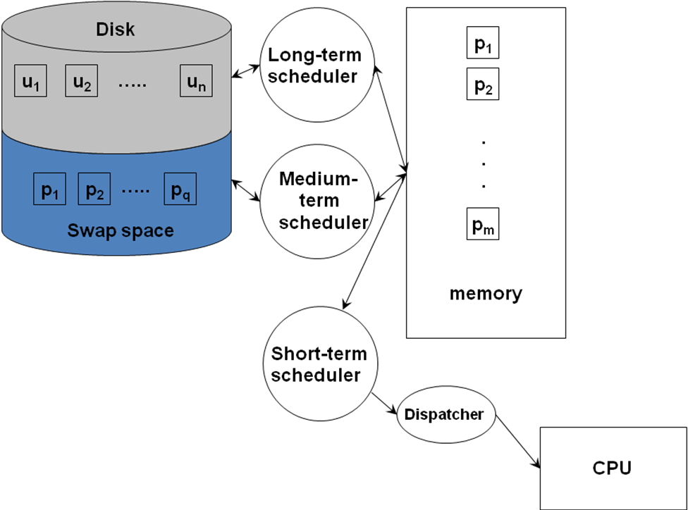
6.3 Scheduling Environments

Slide 9
6.3 Scheduling Environments
Name | Environment | Role
Long term scheduler | Batch oriented OS | Control the job mix in memory to balance use of system resources (CPU, memory, I/O)
Loader | In every OS | Load user program from disk into memory
Medium term scheduler | Every modern OS (time-shared, interactive) | Balance the mix of processes in memory to avoid thrashing
Short term scheduler | Every modern OS (time-shared, interactive) | Schedule the memory resident processes on the CPU
Dispatcher | In every OS | Populate the CPU registers with the state of the process selected for running by the short-term scheduler

Slide 10
6.3 Scheduling Environments
Process States
New
Halted
Admitted
Exit
Interrupt
Ready
Running
Scheduler Dispatch
Waiting
I/O or Event Completion
I/O or Event Wait

Slide 11
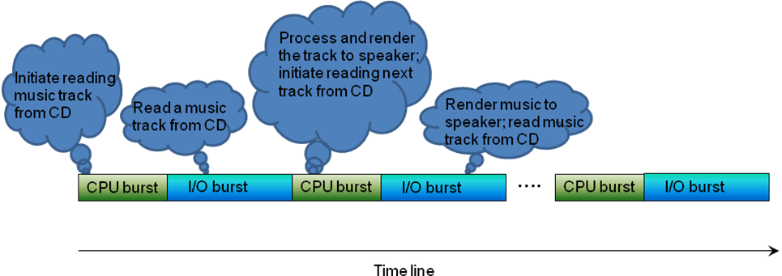
6.4 Scheduling Basics

Slide 12
6.4 Scheduling Basics
Schedulers come in two basic flavors
Preemptive
Non-preemptive
Basic scheduler steps
Grab the attention of the processor.
Save the state of the currently running process.
Select a new process to run.
Dispatch the newly selected process to run on the processor.

Slide 13
6.4 Scheduling Basics
What information is important to know about a process?

Slide 14
6.4 Scheduling Basics
Process Control Block
enum state_type {new, ready, running, waiting, halted};
typedef struct control_block_type {
struct control_block *next_pcb; /* list ptr */
enum state_type state; /* current state */
address PC; /* where to resume */
int reg_file[NUMREGS]; /* contents of GPRs */
int priority; /* extrinsic property */
address address_space; /* where in memory */
…
…
} control_block;
next_pcb
info…

Slide 15
6.4 Scheduling Basics
Partially Executed
Swapped Out Processes
Ready Queue
CPU
I/O
I/O Queue
I/O Request
Time Slice Expired
Child Executes
Fork a Child
Interrupt Occurs
Wait for an
Interrupt

Slide 16
6.4 Scheduling Basics
Name | Description
CPU burst | Continuous CPU activity by a process before requiring an I/O operation
I/O burst | Activity initiated by the CPU on an I/O device
PCB | Process context block that holds the state of a process (i.e., program in execution)
Ready queue | Queue of PCBs that represent the set of memory resident processes that are ready to run on the CPU
I/O queue | Queue of PCBs that represent the set of memory resident processes that are waiting for some I/O operation either to be initiated or completed
Non-Preemptive algorithm | Algorithm that allows the currently scheduled process on the CPU to voluntarily relinquish the processor (either by terminating or making an I/O system call)
Preemptive algorithm | Algorithm that forcibly takes the processor away from the currently scheduled process in response to an external event (e.g. I/O completion interrupt, timer interrupt)
Thrashing | A phenomenon wherein the dynamic memory usage of the processes currently in the ready queue exceed the total memory capacity of the system

Slide 17
6.5 Performance Metrics
System Centric.
CPU Utilization: Percentage of time the processor is busy.
Throughput: Number of jobs executed per unit time.
Average turnaround time: Average elapsed time for jobs entering and leaving the system.
Average waiting time: Average of amount of time each job waits while in system
User Centric
Response time: Time until system responds to user.

Slide 18
6.5 Performance Metrics
Two other qualitative issues
Starvation: The scheduling algorithm prevents a process from ever completing
Convoy Effect: The scheduling algorithm allows long-running jobs to dominate the CPU

Slide 19
6.5 Performance Metrics
P1
P2
P3
w₁
e₁
e₂
e₃
t₁
w₂
t₂
w₃
t₃
w_{i}, e_{i}, and t_{i}, are respectively the wait time, execution time, and the elapsed time for a job j_{i}

Slide 20
6.5 Performance Metrics
P1
P2
P3
2
3
4
3
2
5
5
9
12
14
19
Assume times are in ms

Slide 21
6.5 Performance Metrics
System Centric.
CPU Utilization:
Throughput:
Average turnaround time:
Average waiting time
User Centric
Response time:

Slide 22
6.5 Performance Metrics
Assumptions for following slides
Context switch time is negligible
Single I/O queue
Simple model (first-come-first-served) for scheduling I/O requests.

Slide 23
6.6 Non-preemptive Scheduling Algorithms
Non-preemptive means that once a process is running it will continue to do so until it relinquishes control of the CPU. This would be because it terminates, voluntarily yields the CPU to some other process (waits) or requests some service from the operating system.

Slide 24
6.6.1 First-Come First-Served (FCFS)
Intrinsic property: Arrival time
May exhibit convoy effect
No starvation
High variability of average waiting time

Slide 25
6.6.2 Shortest Job First (SJF)
Uses anticipated burst time
No convoy effect
Provably optimal for best average waiting time
May suffer from starvation
May be addressed with aging rules

Slide 26
6.6.3 Priority
Each process is assigned a priority
May have additional policy such as FCFS for all jobs with same priority
Attractive for environments where different users will pay more for preferential treatment
SJF is a special case with Priority=1/burst time
FCFS is a special case with Priority = arrival time

Slide 27
6.7 Preemptive Scheduling Algorithms
Two simultaneously implications.
Scheduler is able to assume control of the processor anytime unbeknownst to the currently running process.
Scheduler is able to save the state of the currently running process for proper resumption from the point of preemption.
Any of the Non-preemptive algorithms can be made Preemptive

Slide 28
6.7.1 Round Robin Scheduler
Appropriate for time-sharing environments
Need to determine time quantum q: Amount of time a process gets before being context switched out (also called timeslice)
Context switching time becomes important
FCFS is a special case with q = ∞
If n processes are running under round robin they will have the illusion they have exclusive use of a processor running at 1/n times the actual processor speed

Slide 29
6.7.1.1 Details of Round Robin Algorithm
What do we mean by context?
How does the dispatcher get run?
How does the dispatcher switch contexts?

Slide 30
6.7.1.1 Details of Round Robin Algorithm
Dispatcher:
get head of ready queue;
set timer;
dispatch;
Timer interrupt handler:
save context in PCB;
move PCB to the end of the ready queue;
upcall to dispatcher;
I/O request trap:
save context in PCB;
move PCB to I/O queue;
upcall to dispatcher;
I/O completion interrupt handler:
save context in PCB;
move PCB of I/O completed process to ready queue;
upcall to dispatcher;
Process termination trap handler:
Free PCB;
upcall to dispatcher;
Round Robin
Scheduling Algorithm

Slide 31
6.8 Combining Priority and Preemption
Modern general purpose operating systems such as Windows NT/XP/Vista and Unix/Linux use multi-level feedback queues
System consists of a number of different queues each with a different expected quantum time
Each individual queue uses FCFS except base queue which uses Round Robin

Slide 32
6.8 Combining Priority and Preemption
q1
New process
enters here
A process that doesn’t
finish before q_{i} drops
down 1 level
Note:
q1<q2<q3<q4
q2
A process that does
finish before q_{i} goes
up 1 level
q3
Multi-Level
Feedback Queue
q4

Slide 33
6.9 Meta Schedulers
Meta scheduler
Time slices
IJ/BJ
ready_q
PCB₁
PCB₂
…
PCB_{n}
Q
Q
Scheduler for Interactive jobs
(Round Robin)
Scheduler for batch jobs
Priority FCFS
ready_q
PCB₁
PCB₂
…
PCB_{n}

Slide 34
6.10 Evaluation
Evaluate considering domain of application
Desktop: Personal computing.
Servers: Mail servers, file servers, and web servers.
Business: E-commerce and Wall Street style applications.
High-Performance Computing (HPC): Solving scientific and engineering problems.
Grid: HPC with geographically distribution
Embedded: Low-end devices such as cell phones, PDA’s and hybrid combinations as well as sophisticated computing systems found in automobiles and aircraft.
Pervasive: Emerging domain combining elements of HPC and embedded computing.

Slide 35
6.10 Evaluation
Domains | Environment | Workload characteristics | Types of schedulers
Desktop | Timeshared, interactive, multiprogrammed | I/O bound | Medium-term, short-term, dispatcher
Servers | Timeshared, multiprogrammed | Computation bound | Medium-term, short-term, dispatcher
Business | Timeshared, multiprogrammed | I/O bound | Medium-term, short-term, dispatcher
HPC | Timeshared, multiprogrammed | Computation bound | Medium-term, short-term, dispatcher
Grid | Batch-oriented, timeshared, multiprogrammed | Computation bound | Long-term, Medium-term, short-term, dispatcher
Embedded | Timeshared, interactive, multiprogrammed | I/O bounds | Medium-term, short-term, dispatcher
Pervasive | Timeshared, interactive, multiprogrammed | Combination of I/O bound and computation bound | Medium-term, short-term, dispatcher

Slide 36
6.11 Summary and a Look ahead
Name | Property | Scheduling criterion | Pros | Cons
FCFS | Intrinsically non-preemptive; could accommodate preemption at time of I/O completion events | Arrival time (intrinsic property) | Fair; no starvation; | high variance in response time; convoy effect
SJF | Intrinsically non-preemptive; could accommodate preemption at time of new job arrival and/or I/O completion events | Expected execution time of jobs (intrinsic property) | Preference for short jobs; provably optimal for response time; low variance in response times | Potential for starvation; bias against long running computations
Priority | Could be either non-preemptive or preemptive | Priority assigned to jobs (extrinsic property) | Highly flexible since priority is not an intrinsic property, its assignment to jobs could be chosen commensurate with the needs of the scheduling environment | Potential for starvation
SRTF | Similar to SJF but uses preemption | Expected remaining execution time of jobs | Similar to SJF | Similar to SJF
Round Robin | Preemptive allowing equal share of the processor for all jobs | Time quantum | Equal opportunity for all jobs; | Overhead for context switching among jobs

Slide 37
6.12 Linux Scheduler – A case study
Scheduler designed to match personal computing and server domains
Goals
High efficiency
Spending as little time as possible in scheduler, important goal for server environment
Support for interactivity
Important for the interactive workload of the desktop environment
Avoid starvation
Ensure that computational workload do not suffer as a result of interactive workloads
Support for soft real-time scheduling
Meet the demands of interactive applications with real-time constraints

Slide 38
6.12 Linux Scheduler – A case study
Linux scheduler recognizes three classes of tasks:
Real-time FCFS
Real-time round robin
Timeshared
Scheduler has 140 priority levels.
Levels 0-99 for real-time tasks
Remaining levels for timeshared tasks.

Slide 39
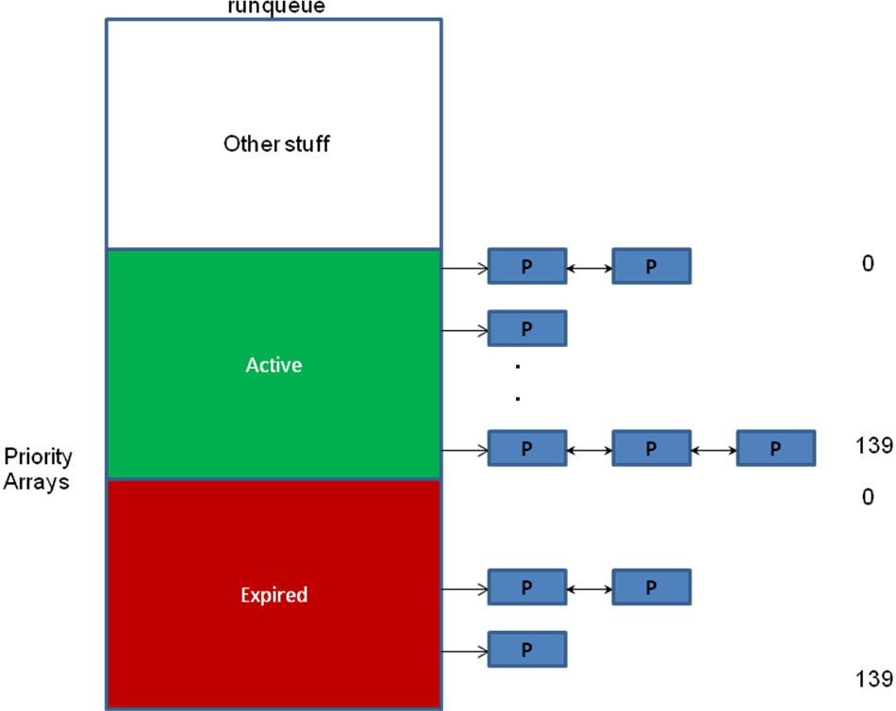
6.12 Linux Scheduler – A case study

Slide 40
6.12 Linux Scheduler – Algorithm
Pick first task with highest priority from active array and run it.
If task blocks (due to I/O) put it aside and pick next highest one to run.
If time quantum runs out (does not apply to FCFS tasks) for currently scheduled task then place it in expired array.
If a task completes its I/O then place it in active array at right priority level adjusting its remaining time quantum.
If there are no more tasks to schedule in active array, simply flip active and expired array pointers and continue with scheduling algorithm (i.e., expired array becomes the active array and vice versa).

Slide 41
6.13 Historical Perspective
Babbage
ENIAC
FORTRAN/FMS
IBSYS /IBM 7094/JCL
Scientific/Business Users…IBM S/360
Timesharing/MULTICS
Unix
Personal Computing/Windows/Linux

Slide 42
Questions?

